Slide 1

From Modeling to Evaluation

Slide 2
Objectives
Understanding Modeling
Understanding Evaluation
Data Science Methodology

Slide 3
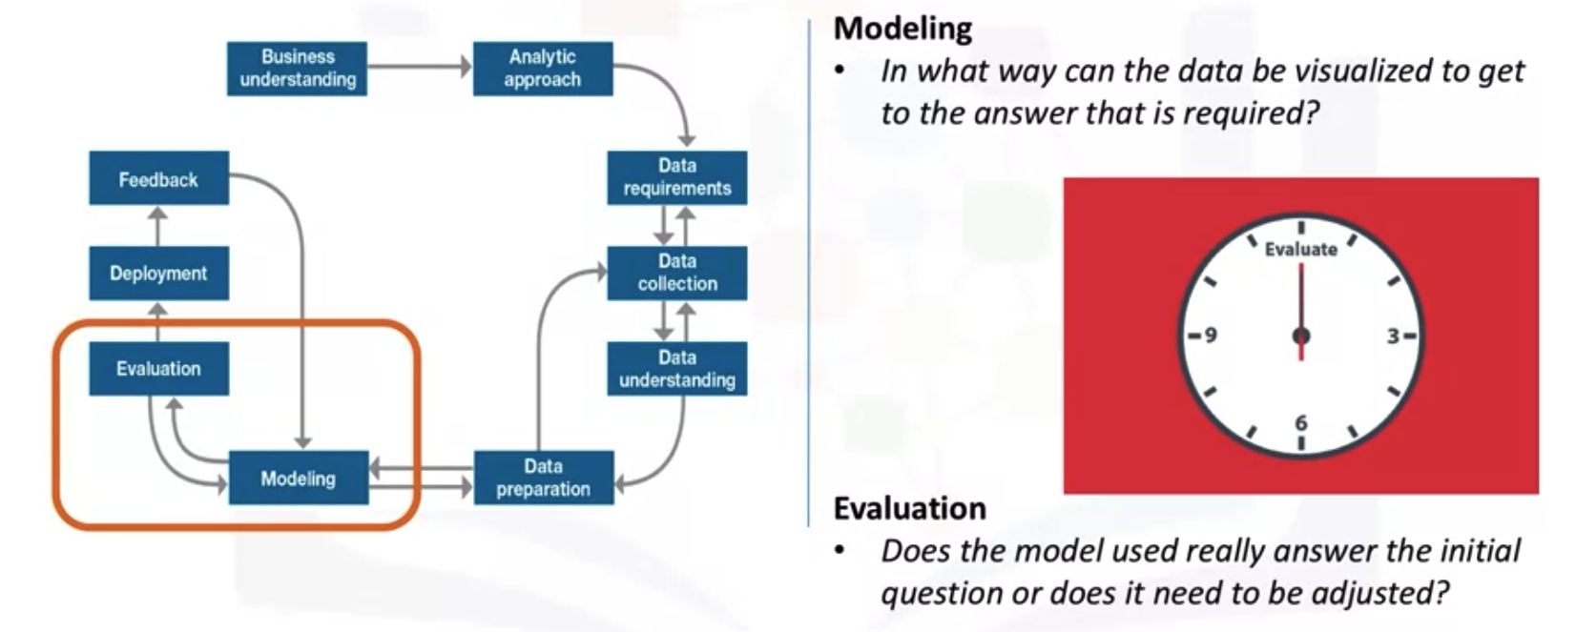
Understanding Modeling
Data Science Methodology

Slide 4
Understanding Modeling
Modelling is the stage in the data science methodology, where the data scientist has the chance to sample the “sauce” and determine, if it's bang on or in need of more seasoning!
The modelling is geared toward answering two key questions:
  First, what is the purpose of data modeling
  Second, what are some characteristics of this process? Data
Modelling focuses on developing models that are either descriptive or predictive.
Data Science Methodology

Slide 5
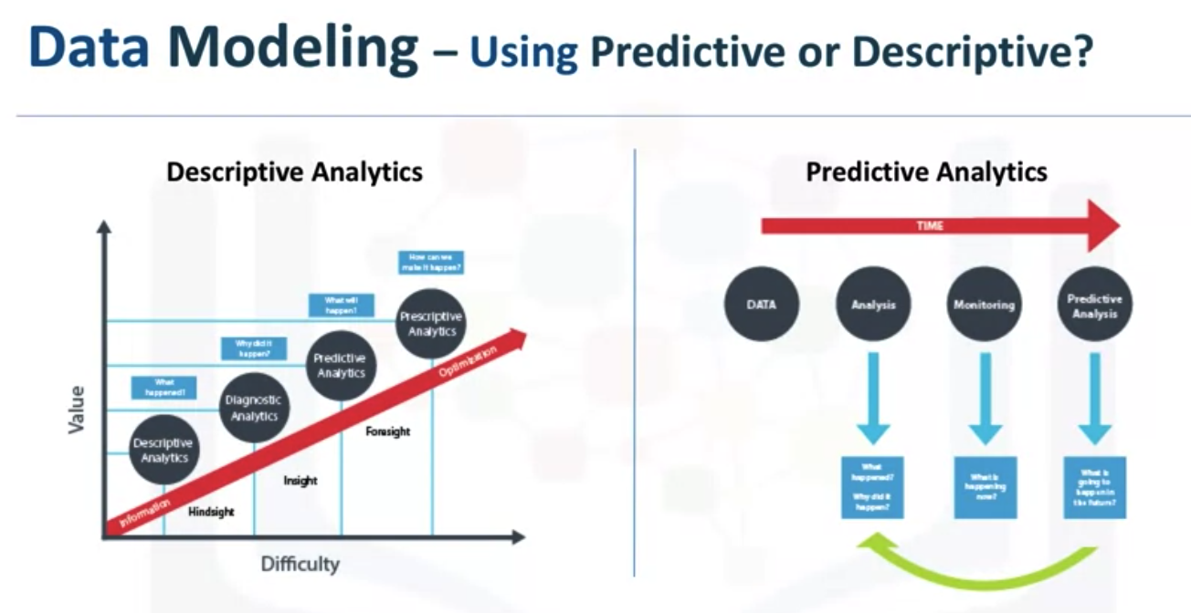
Understanding Modeling
Data Science Methodology

Slide 6
Understanding Modeling
The data scientist will use a training set for predictive modelling.
A training set is a set of historical data in which the outcomes are already known.
The training set acts like a gauge to determine if the model needs to be calibrated.
In this stage, the data scientist will play around with different algorithms to ensure that the variables in play are actually required.
The success of data compilation, preparation and modelling, depends on the understanding of the problem at hand, and the appropriate analytical approach being taken.
Data Science Methodology

Slide 7
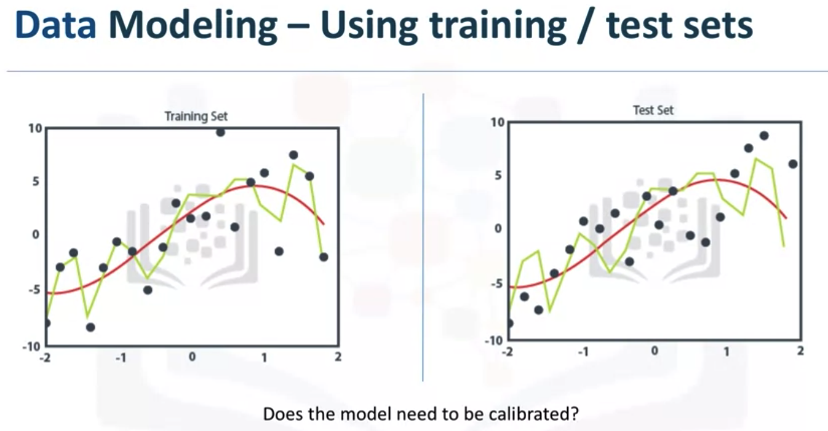
Understanding Modeling
Data Science Methodology

Slide 8
Understanding Modeling
The data supports the answering of the question, and like the quality of the ingredients in cooking, sets the stage for the outcome.
Constant refinement, adjustments and tweaking are necessary within each step to ensure the outcome is one that is solid.
TIn John Rollins' descriptive Data Science Methodology, the framework is geared to do 3 things:
  First, understand the question at hand.
  Second, select an analytic approach or method to solve the problem, and third, obtain, understand, prepare, and model the data.
The end goal is to move the data scientist to a point where a data model can be built to answer the question.
Data Science Methodology

Slide 9
Understanding Modeling
In this stage of the methodology, model evaluation, deployment, and feedback loops ensure that the answer is near and relevant.
This relevance is critical to the data science field overall, as it is a fairly new field of study, and we are interested in the possibilities it has to offer.
The more people that benefit from the outcomes of this practice, the further the field will develop
Data Science Methodology

Slide 10
Understanding Evaluation
Data Science Methodology

Slide 11
Understanding Evaluation
A model evaluation goes hand-in-hand with model building as such, the modeling and evaluation stages are done iteratively.
Model evaluation is performed during model development and before the model is deployed.
Evaluation allows the quality of the model to be assessed but it's also an opportunity to see if it meets the initial request.
Evaluation answers the question: Does the model used really answer the initial question or does it need to be adjusted?
Data Science Methodology

Slide 12
Understanding Evaluation
Model evaluation can have two main phases.
  The first is the diagnostic measures phase, which is used to ensure the model is working as intended. If the model is a predictive model, a decision tree can be used to evaluate if the answer the model can output, is aligned to the initial design. It can be used to see where there are areas that require adjustments.
  The second phase of evaluation that may be used is statistical significance testing. This type of evaluation can be applied to the model to ensure that the data is being properly handled and interpreted within the model. This is designed to avoid unnecessary second guessing when the answer is revealed
Data Science Methodology

Slide 13
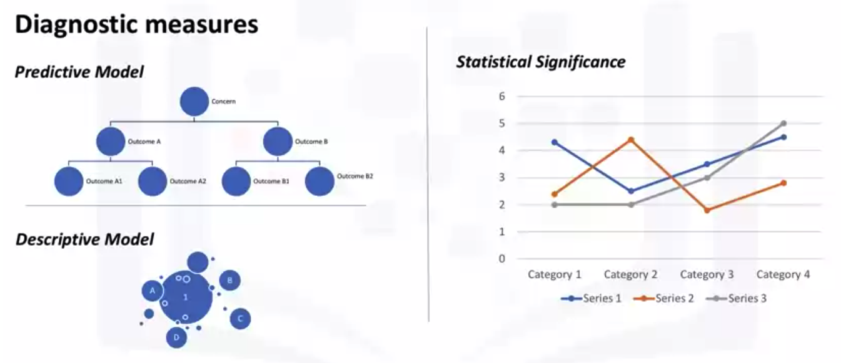
Understanding Evaluation
Data Science Methodology

Slide 14
Summary
Understanding Modeling
Understanding Evaluation
Data Science Methodology

Slide 15
Q & A
Data Science Methodology

